Slide 1

Principles of
Operating System
MASS-STORAGE STRUCTURE

Slide 2


Structure
Disk drives are addressed as a large one-dimensional array of logical blocks
  One logical block is the
  smallest unit of transfer.
  The size of a logical block
  is usually 512B.

Slide 3

Logical blocks mapping onto disk
Sector 0 is the first sector of the first track on the outermost cylinder.
Mapping in order
  through that track,
  then the rest of the tracks in that cylinder,
  and then through the rest of the cylinders from outermost to innermost.

Slide 4
Scheduling
The operating system is responsible for using hardware efficiently — for the disk drives, this means having a fast access time and disk bandwidth.
Access time has two major components
  Seek time is the time for the disk are to move the heads to the cylinder containing the desired sector.
  Rotational latency is the additional time waiting for the disk to rotate the desired sector to the disk head.

Slide 5
Scheduling algorithms
Several algorithms exist to schedule the servicing of disk I/O requests.
We illustrate them with a request queue (0-199).
98, 183, 37, 122, 14, 124, 65, 67
Head pointer 53

Slide 6

FCFS
Illustration shows total head movement of 640 cylinders.

Slide 7

SSTF
Selects the request with the minimum seek time from the current head position.
  SSTF scheduling is a form of SJF scheduling; may cause starvation of some requests.
  Illustration shows
  total head movement
  of 236 cylinders.

Slide 8

SCAN
Sometimes called the elevator algorithm
  The disk arm starts at one end of the disk, and moves toward the other end,
  servicing requests until it gets to the other end of the disk, where the head movement is reversed and servicing
  continues.
  Illustration shows total
  head movement of 208
  cylinders.

Slide 9

C-SCAN
The head moves from one end of the disk to the other. servicing requests as it goes.
  When it reaches the other end, however, it immediately returns to the beginning of the disk, without servicing any requests on the return trip.
  Treats the cylinders
  as a circular list that
  wraps around from
  the last cylinder to
  the first one.

Slide 10

C-LOOK
Version of C-SCAN
  Arm only goes as far as the last request in each direction,
  then reverses direction immediately, without first going all the way to the end of the disk.

Slide 11
Selecting a Disk-Scheduling Algorithm
Performance depends on the number and types of requests.
Requests for disk service can be influenced by the file-allocation method.
SSTF is common and has a natural appeal
SCAN and C-SCAN perform better for systems that place a heavy load on the disk.
Either SSTF or C-LOOK is a reasonable choice for the default algorithm.

Slide 12
Disk Management
Low-level formatting, or physical formatting
  Dividing a disk into sectors that the disk controller can read and write.
To use a disk to hold files, the operating system still needs to record its own data structures on the disk.
  Partition the disk into one or more groups of cylinders.
  Logical formatting or “making a file system”.
Methods such as sector sparing used to handle bad blocks.

Slide 13
Swap-Space Management
Swap-space : Virtual memory uses disk space as an extension of main memory.
Swap-space can be carved out of the normal file system,or, more commonly, it can be in a separate disk partition.

Slide 14
RAID
RAID: Redundant Arrays of Independent Disks.
  Multiple disk drives provides reliability via redundancy.
RAID schemes improve performance and improve the reliability of the storage system by storing redundant data.
  Mirroring or shadowing keeps duplicate of each disk.
  Block striping provides high data-transfer rates.
RAID is arranged into six different levels.

Slide 15
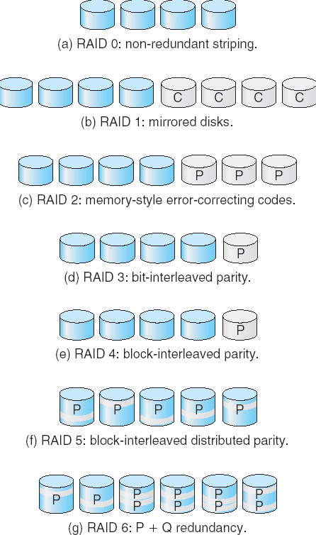
RAID Levels

Slide 16
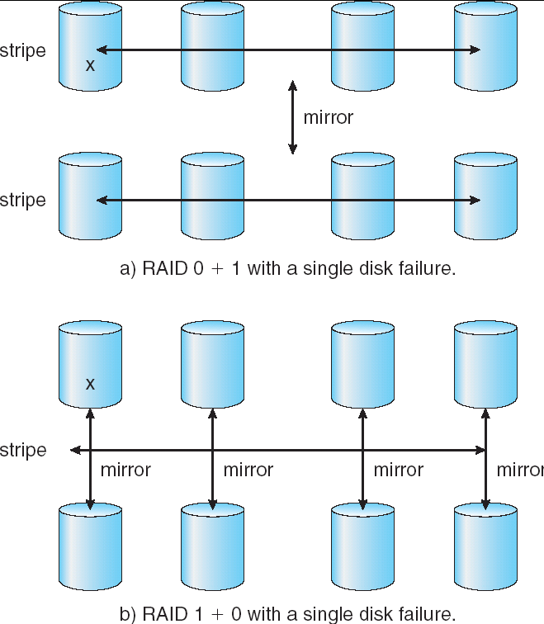
RAID Levels

